Slide 1
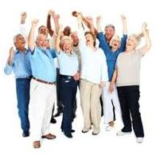
East Riding of Yorkshire
Evaluating the Leisure Centre's contribution to outcomes
Gillian Barley,
Performance Group Manager

Slide 2
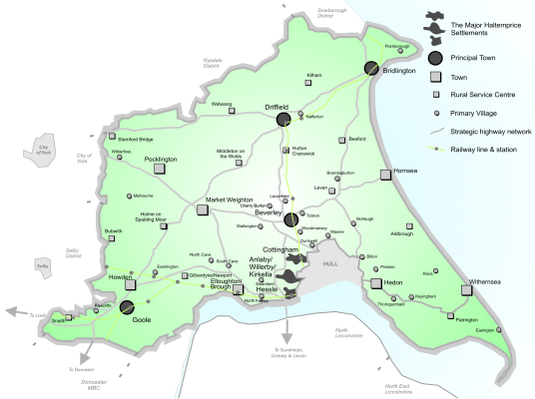

Slide 3
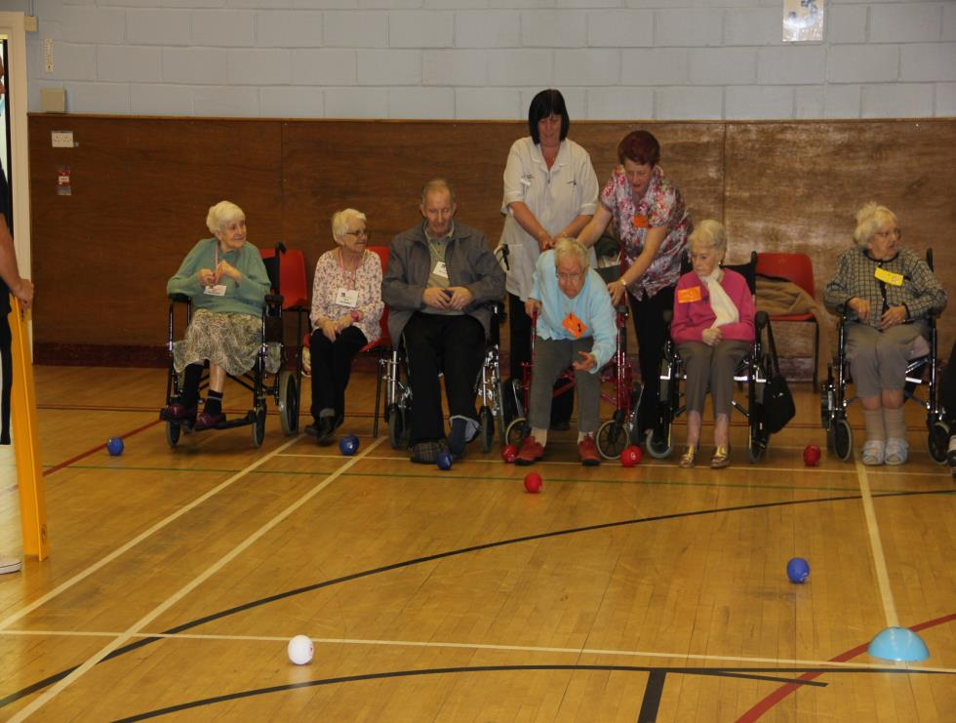
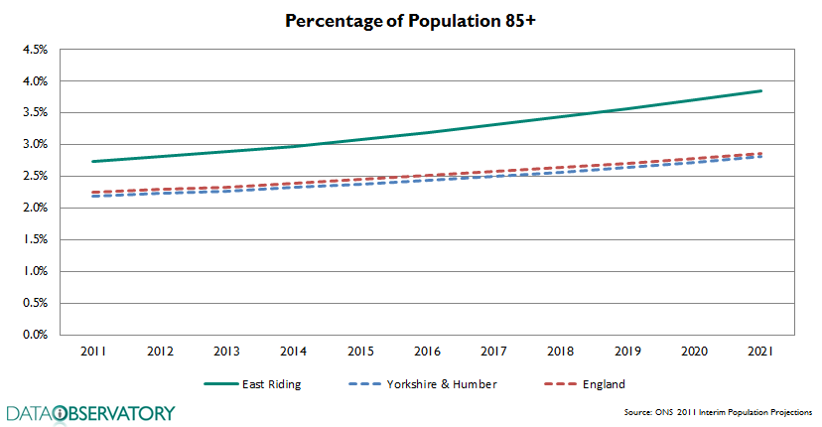
A predicted 91% increase in residents aged 75 and over having a moderate or severe visual impairment
Prevalence of dementia in persons aged 65 and over is projected to increase by 99% by 2030

Slide 4
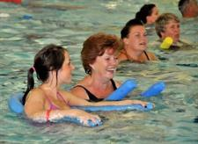
East Riding Leisure
“Going beyond what our customers expect”
APSE Leisure, Sport and Cultural team of the Year 2009/10, 2011/12 and 2013/14
APSE Best performing Leisure Centre of the Year 2011/12, 2012/13 and 2013/14
UK’s no 2 service for customer satisfaction across Private and Public sectors
Winner – UK customer service innovation team of the Year across Private and Public Sector 2012

Slide 5
The things that have to come together
The world of public sector Leisure Services is changing.
Close to the customer
Information technology
Collaborate
Health agenda at the heart
Some facts:
East Riding Leisure caters for 4.5m (6m) visits
Operate 330 (450) health and fitness classes a week
20% of East Riding population have a Leisure Card

Slide 6

Case studies
Live Well funded by
NHS East Riding of Yorkshire
Andrew said;
“I think without Live Well I would
not have lost as much fat as I have
done in such a short amount of
time. I haven’t as much loose skin as
I thought I would, which I owe to
the workouts and the support I was
given from all staff at the leisure
centre”.

Slide 7
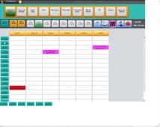
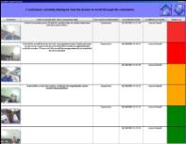

Walking the journey through –performance managed
Andrew’s journey…went like….
Customer contact bar
Leisure Card/CRM
GP Surgery Bookings
Customer Contact Bar
Customer
Information
Bookings and GP referral
Capturing information at every opportunity and using it to personalise the service

Slide 8

Missing part of the Jigsaw………….
Show the value of the Service to those that want to keep the mainstream population healthy and what can we learn from it to improve existing service.
Target question and Audience for focus
Does the promotion of physical activity through leisure centre based activities for adults aged between 50 and 60 years of age reduce their healthcare costs?

Slide 9

Our research
– finding the missing piece
Using a range of research techniques the team has helped decision-makers understand the motivational drivers, experiences and benefits that individuals aged between 50 – 60 years have when taking part in regular exercise through a local authority leisure facility

Slide 10
Our methodology
Desk research to establish existing evidence including national medical research, other local authorities and academic research
40 Semi structured qualitative interviews
Medical assessment
Use of Nvivo to analyse the interviews

Slide 11
Our research cohort
East Riding Leisure Sure Card Members
Population
(13,240)
Active Members
East Riding Household by segment
50 – 60 year olds
By gender
Target group
(3,000)
Representative sample
East Riding segments
Random selection , only identification post code, gender, and membership number
Targeted number of interviews per site
(determined by size of membership per site)
Selection
(40)
Sub group
Specified GP match to Dr. C,

Slide 12
Semi structured interviews
7 leisure centres targeted across East Riding
Briefing to Leisure staff – direct ‘recruitment’ of customer/ interviewee, high street voucher offered
Interview arranged around their activities, within the Leisure Centre carried out by ‘independent’ internal research staff
Audio recording of each interview
Semi structured interview covering 4 areas: Routes into physical activity; Taking Part; Maintaining physical activity into the future; Role of the leisure centre; likert scale some simple demographics
Average length = 40 minutes

Slide 13

GP health assessment
Areas of assessment and methodology agreed with GP
Letter sent to Leisure Members within Dr C catchment requesting permission to share data
Small number (4) responded
Information shared with GP
Health assessment carried out at GP, with past data on appointments, treatment etc analysed and summary returned

Slide 14

Key findings – Literature Review
Strong evidence shows the beneficial effects of exercise is indisputable
Regular physical activity during middle age in particular impacts upon both all cause mortality and a range of chronic physical and mental illnesses, disease and conditions
General health benefits – “the risk of poor health from inactivity is very high (Department of Health 2010)
Particular health benefits – blood pressure, cardiovascular health, colorectal and breast cancers, osteoporosis and muscle/joint health, obesity, cognitive health, sexual health, mental health and wellbeing

Slide 15
Key findings
“It takes your mind off things, it’s ME time”
Members fell into 3 categories:
  ‘Habitual exercisers’ – exercised throughout life, habit/part of daily routine, competitive sports, extremely motivated to improve performance/health
  ‘Behaviour changers’ – trigger made them do it, health issues, ageing/mobility, weight gain
  ‘Feel good socialisers’ – regular users, enjoy socialising, casual programme, takes breaks from participating

Slide 16
Key findings
“It takes your mind off things, it’s ME time”
Likert scale – average reported increase in health and wellbeing score across all 3 types were similar, but ‘Habitual’ and ‘Feel Good Socialisers’ were slightly higher than ‘behaviour changers’
Active lifestyles MUST start at a young age to establish positive healthy behaviours
There were no key differences in behaviour across the East Riding (leisure centres) although sense of community was evident

Slide 17
By gender, by ‘type’

Slide 18
Habitual exercisers
“I want to go further, I want to do more, I haven’t enough days in the week to get enough classes in”
Sport/exercise has always been part of their lives
Extremely self motivated
Active participation in competitive sports
Injury and/or symptoms of ageing has led to change in type of activity but not the frequency
Exercise is a habit, with other commitments/interests being planned around exercise
Often seek out other opportunities to exercise if away from home or habit is interrupted e.g. holiday
Some reported a sense of guilt if they didn’t exercise
Overwhelmingly they felt the real benefits of feeling fit and healthy in body and mind
Little support or understanding of those people who don’t exercise
70% males
Uses both gym and classes
☺ = 4.5

Slide 19

Habitual – Male – Case 28

Slide 20
Behaviour changers
“I used to smoke quite a lot, I gave up 8 years ago and I saw it as a way of occupying my mind, it was a good way of getting out of the bad habits I had before”
Most would describe themselves as ‘active’
The major trigger was health (blood pressure, weight gain, early diabetes)
Some reported concerns about hereditary illnesses (Alzheimer's, cancer etc)
Many referred to signs of ageing and fear of becoming less independent or able to do the things they enjoy in retirement due to immobility and associated age related health conditions
Common theme was that they exercised with others (mother/daughter/siblings), enjoyed interaction through classes
Those who exercised reported that they also tend to eat healthily too
Similar proportion males/females
Most common type of males
☺ = 4

Slide 21
Trigger – Male – Case 15

Slide 22
Feel Good Socialisers
“Its nice to come out and meet people and interact with them, go for a coffee after or something like that. It’s the social side as well as the fitness”
Will often arrange to meet friends or will go with someone
Some offered to become a ‘buddy’ for new members
Looked for activities that filled their week, gave purpose/structure
Many were retired, some living alone
Didn’t set specific health goals and often followed their own programme, weren’t looking to ‘push themselves’ especially those in the gym
Many saw the classes as a more sociable activity and recognised that you could help each other and push yourself more in a class
Some were reluctant to come but if it meant they could socialise it motivated them to attend
70% females
Most common ‘type’ of females
Highest improved score of 9
☺ = 4.5

Slide 23
Regular – Female – Case 21

Slide 24
Key findings: GP Health assessment
Factor | Result
Unscheduled visits to the nurse | Some reductions 2 patients dropped from 5 to 1 annually
Unscheduled visits to the Dr | Some reductions 3 patients dropped from 15 visits to 3
Requests for prescriptions | All reduced
Weight | All reduced
BMI | All reduced by an average of 2.2
Well-being | All improved From an average likert score 4.25 out of 10 to 7.62
All four (2 male, 2 female):
Felt better
Were prescribed fewer medications
Had lost weight

Slide 25
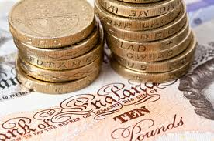
Key findings: GP Health assessment
All four (2 male, 2 female):
Felt better
Were prescribed fewer medications
Had lost weight
Treatment | Cost
Gastric Banding | £5,000 to £8,000 per person
Coronary artery bypass graft | £12,000 per person
Diabetes | £1.5 million AN HOUR
Human Insulin | £255.2 million (2009/10)
Absenteeism | £8.4 billion per year

Slide 26

Why East Riding Leisure?
Staff were supportive with a friendly atmosphere
Contact/instruction at the start - then customer led, all said it was there if they wanted it
Welcoming, hub of the community, they feel comfortable in the building, going to classes/new classes, sense of familiarity
Private gyms can be overcrowded
Pricing was important – corporate membership was attractive to many people, providing value for money
Many had a Health Check (often the ‘worried well’) and said that this gave reassurance that they are doing the right thing. The also said they would be willing to pay for a follow-up assessment.

Slide 27
What can East Riding do to encourage others?
Recognised a lot of money is spent on promoting healthy lifestyles but difficulty in engaging those who don’t want to exercise
Exercise and health needs to start at an early age, it needs to become part of life/routine
Social route can be a mechanism to engagement and onward to regular physical activities
More variety of programme (times of day, levels/type of activity)

Slide 28
What can East Riding do to encourage others?
Taster ‘Drop-in’ sessions (short 30 mins) – “if you attend your first class which is an hour it can put you off from coming back!”
Use of ‘buddies’ to meet and greet outside of the building, “people think the place is full of fit people in leotards we need to change perceptions”
Use different locations in the community, use older people to run the classes/support people in the gym
“You’ve got to have experienced the benefits of being healthy”

Slide 29
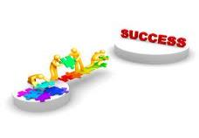
What would we do differently
Evidence suggests that whilst Members should have been selected at random, staff contacted people they knew or who they felt would take part
The briefing hadn’t cascaded to leisure staff, Members thought we were carrying out a satisfaction survey
Very few people said that they needed the incentive to take part – but all took it!
The sample size was too big, 40 interviews x 40 mins qualitative data = significant coding! We could have found saturation point sooner.

Slide 30
So how is this research being used?
Validates the increase of classes offered
Health Plus
Buddy systems
Sure Card online technology
Help us to move from 4.7m visits to 6 million visits per annum, reduce net cost of leisure service/contribute to council budget reduction

Slide 31

So what’s next?
Focus Group of less active residents (through existing forum, established groups, networks)
Also, considering resident survey to examine active lifestyles and health (targeted – aged 50 years and over)
Regular monitoring of health benefits for all new leisure users and after 6 months activity
Share the results with the CCG and Health and Wellbeing Board

